Slide 1
Alleles

Slide 2
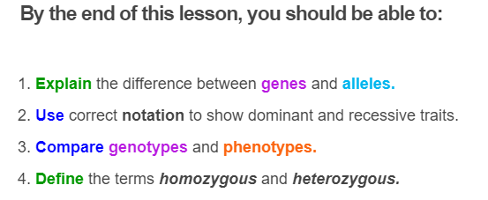


Slide 3
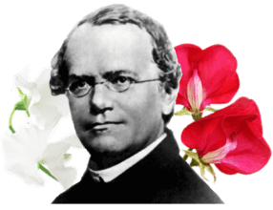
Mendel bred pea plants to study the inheritance of traits. He studied a variety of characteristics, including pea colour, pea shape and stalk height.
In this Smart Lesson, we will focus on just one of these characteristics: the flower colour of the peas.

Slide 4



Mendel discovered that flower colour in peas is controlled by something he called factors.
Each plant has two factors. This means that plants could carry two red, two white or one red and one white factor.
The factor for red flowers is dominant, meaning if it is present in at least one of the two factors, then the pea will have red flowers.

Slide 5
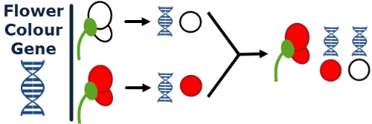
Our understanding of genetics has come a long way since Mendel did his experiments.
We now know that the flower colour of Mendel's pea plants was controlled by one gene.
Each plant has two copies of that gene: one from its mother and one from its father.
Each copy can code for either red or white flowers.

Slide 6
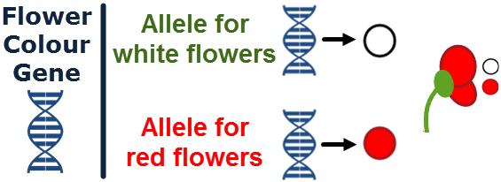
This means that there are two variations of the flower colour gene.
One variation codes for red flowers and one variation codes for white flowers. We call these variations alleles.
The plant below has an allele for red flowers and an allele for white flowers. The allele for red flowers is dominant, so the pea has red flowers.

Slide 7
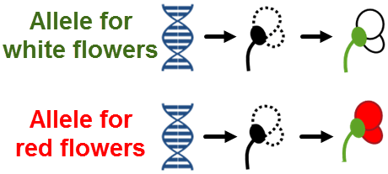
Alleles are variations of a gene.
A gene's alleles will control the same characteristic, but can code for different variations of that characteristic. Different variations of the same gene are known as traits.
In this case, both alleles contain information about flower colour, but one codes for a red flower while the other codes for a white flower.

Slide 8
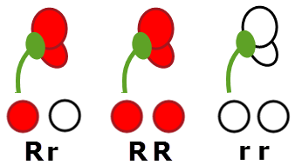
So far we have been drawing alleles as different coloured circles, but they have their own special notation.
Alleles are referred to using letters.
The recessive allele is given a small letter (r) and the dominant allele is given a capital letter (R).
It doesn't matter what letter we choose. For instance, we could have used W and w or F and f.

Slide 9
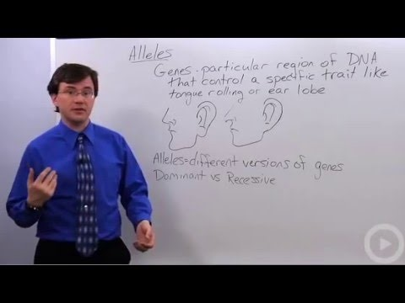

Slide 10
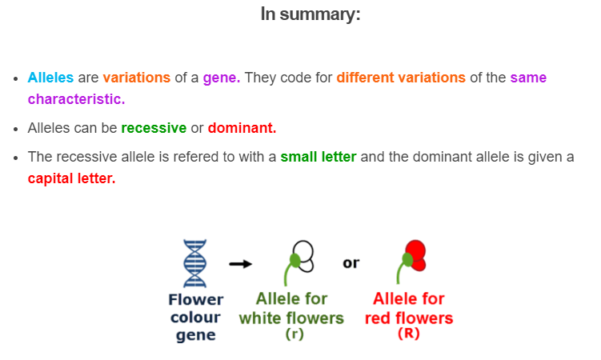

Slide 11
You should now know that a pea plant has two alleles for each gene.
But why does it carry two?

Slide 12
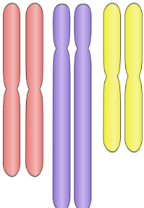
The answer lies in their chromosomes.
The species of pea that Mendel used is diploid, just like humans are. This means they have two copies of each chromosome.

Slide 13
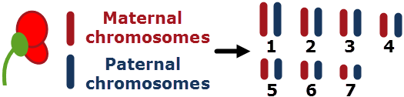
One copy of each chromosome is from the mother and one is from the father.
The maternal and paternal copy of the same chromosome form a homologous pair and are called homologous chromosomes.
Mendel's peas have 7 homologous pairs of chromosomes.

Slide 14
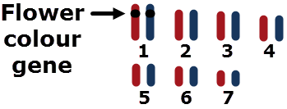
Homologous chromosomes contain the same genes.
Because of this, together they give the pea two copies of each gene they contain. In Mendel's peas, the largest chromosome, chromosome 1, holds the gene for flower colour.
Together, the maternal and paternal copies of chromosome 1 provide the pea with two copies of the flower colour gene.

Slide 15

Each copy of the flower colour gene can code for red flowers or for white flowers.
Remember, variations of a gene are called alleles.
So a pea plant can have two alleles that code for red flowers, two that code for white flowers or one that codes for red and one that codes for white.

Slide 16
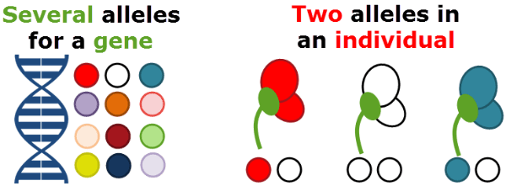
An important thing to remember is that a gene can have more than two alleles.
Some genes have dozens of alleles! For example, the flower colour gene could have alleles that code for several different flower colours including red, white and blue.
However, an individual can only have two of these alleles in their DNA, because they only have two copies of each chromosome.

Slide 17

There are some special terms we need to know when discussing alleles.
Firstly, a person's alleles make up their genotype.
The trait these alleles result in are called their phenotype.
For example, Susan has two alleles for a gene controlling eye colour. One codes for brown eyes (B) and one codes for blue eyes (b). Her genotype is therefore Bb. The allele for brown eyes is dominant so Susan has brown eyes. This is her phenotype.

Slide 18


An individual can be either homozygous or heterozygous for a particular trait.
If an individual has two of the same allele, then they have a homozygous genotype. If the allele is dominant (RR), they are homozygous dominant. If the allele is recessive (rr), they are homozygous recessive.
(Homo = same in Greek)
If an individual has two different alleles, then they are heterozygous.
(Hetero = different in Greek)

Slide 19


Slide 20
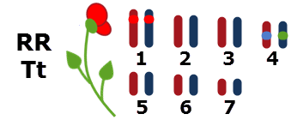
Individuals have many genes on their chromosomes and can be heterozygous for one gene but homozygous for another gene.
For example, in peas, the fourth chromosome contains a gene that controls the stalk height of a plant. It has two alleles: tall (T) or short (t).
This pea plant is homozygous dominant for flower colour and heterozygous for stalk height.

Slide 21


